Slide 1


Autonomous underwater vehicle for sea water intake
tunnel inspection and cleaning for nuclear plant
Review-I
AY 2025-26
Capstone Project – Introduction (PROJ2999)
GITAM (Deemed-to-be) University
Department of Electrical Electronics and Communication Engineering
Project Team:
Polisetty Karthik
N Uday Mahesh Teja
Project Mentor:
Dr. Sunita Panda
Project In-charge:
XXX
www.gitam.edu

Slide 2
Objective and Goals
Objective
• Inspect seawater intake tunnels: Use sensors and cameras to detect debris,
sedimentation, or other issues that may affect the tunnel's functionality.
• Clean seawater intake tunnels: Utilize cleaning mechanisms or tools to remove debris
and sedimentation, ensuring optimal water flow.
• Navigate through tunnels: Develop navigation algorithms and control systems to
enable the AUV to maneuver through the tunnels efficiently.
• Collect data: Gather data on water quality, flow rates, and tunnel conditions using
various sensors, such as temperature, pH, and pressure sensors.
• Autonomous operation: Autonomous control and navigation, minimizing human
intervention.
Goals
• Robust Communication: Establish reliable communication systems to transmit
data and control commands between the AUV and the surface.
• Reduced Downtime: Minimize downtime and maintenance costs by automating
inspection and cleaning tasks.
• Reliable Inspection: Conduct thorough inspections of seawater intake tunnels to
detect potential issues, such as debris, sedimentation, or damage

Slide 3
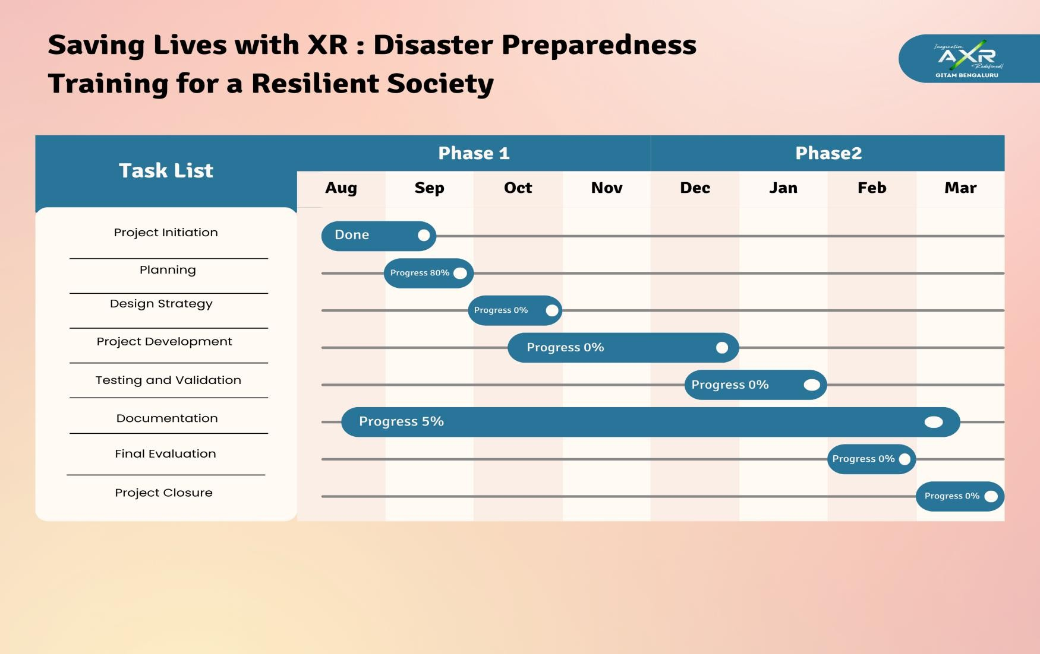
Project Plan

Slide 4
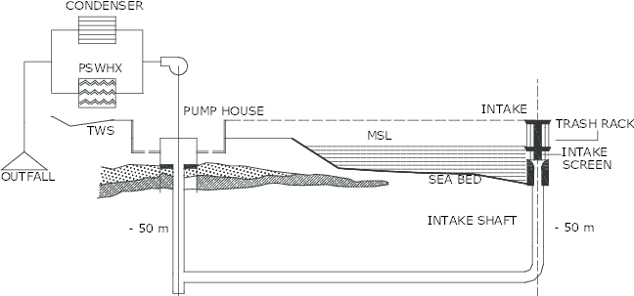

Slide 5
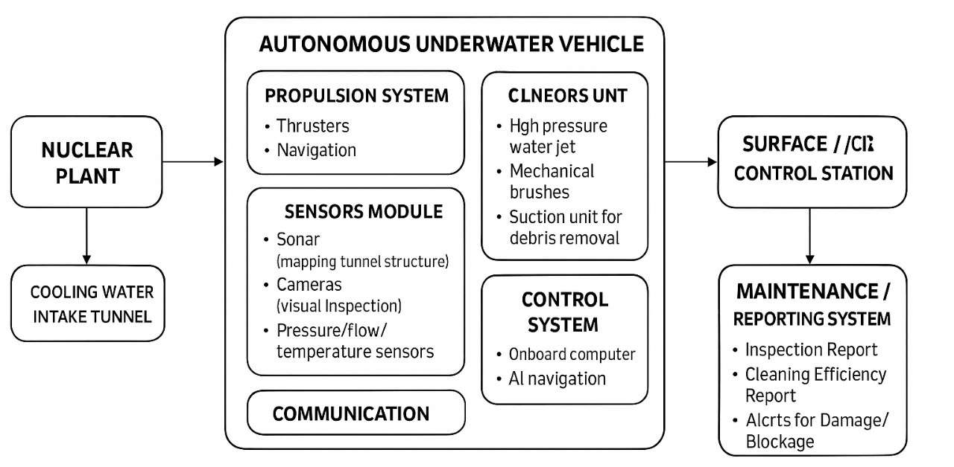
Architecture
Structural Diagram
Block Diagram :

Slide 6
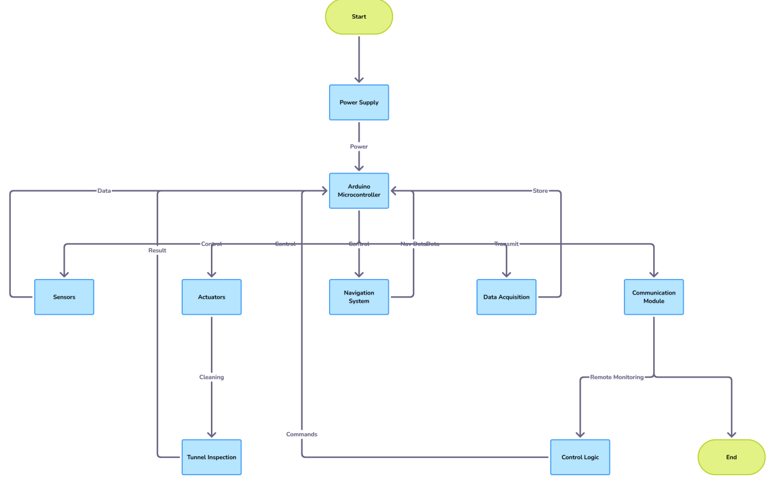
FLOW CHART:

Slide 7
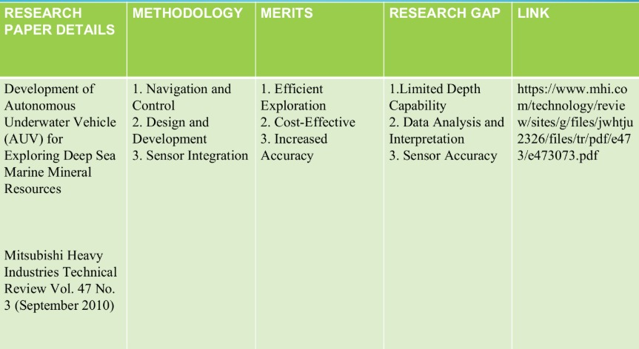
Literature Survey

Slide 8
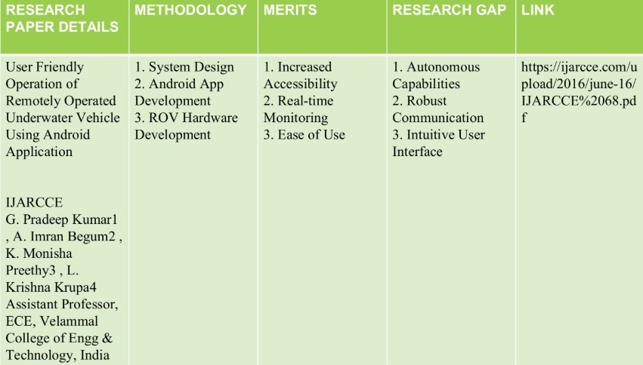

Slide 9
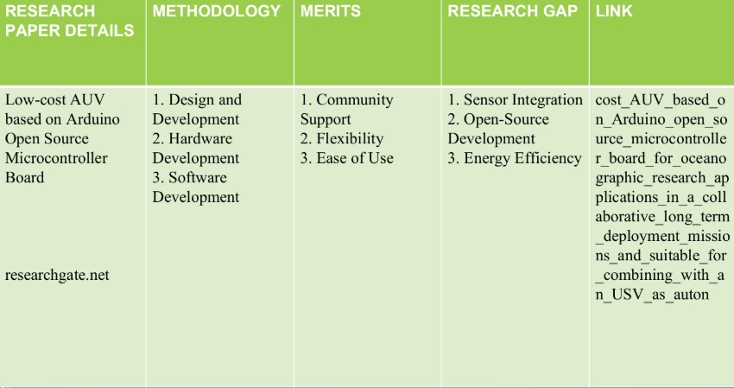
Literature Survey

Slide 10
Use Cases & Testing
Use Cases
∙Biofouling / marine growth: Seaweed, barnacles, molluscs etc. adhere to walls, screens or surfaces, increasing hydraulic resistance (head loss), reducing flow, increasing energy use or lowering cooling capacity.
∙Sedimentation & debris: Sediment buildup, debris or silt accumulation can block inlets, damage screens or filters, or restrict flow, leading to operational issues.
∙Corrosion, cracks, structural degradation: Concrete or metal tunnels may degrade over time; early detection is crucial to avoid catastrophic failure.
∙Clogging of heat exchangers / condensers: If organisms or debris pass through intake systems they can damage or clog cooling tubes
Test Cases
∙Tunnel traversal & mapping under typical flow: verify that the AUV can traverse the full length of the intake tunnel while mapping geometry and surface condition during normal operational water flow.
∙Cleaning performance: To assess ability of the cleaning tools (brushes, jets, suction) to remove fouling, sediment buildup without damaging surfaces.
∙Redundancy & failure recovery: Test behavior if key systems fail: CPU, sensors, communications, propulsion, etc. Ensure vehicle can self‑rescue or be recovered.

Slide 11
Conclusion & Future Work
Summary and Conclusion
Sea water intake tunnels in nuclear power plants are critical infrastructure. They must allow sufficient cooling water flow, resist marine growth and sediment clogging, and remain structurally sound (no cracks, corrosion or deformation). Maintenance and inspection are mandatory for safety, regulatory compliance, and operational efficiency.
It is feasible to design, prototype or simulate an AUV system that can perform inspection (mapping + defect detection, e.g. siltation or cracks) in a controlled or scaled test environment. Designing full‑scale cleaning capability under realistic nuclear plant conditions is more challenging but possible with careful trade‑offs.
Future Work
Advanced Sensor Fusion for Improved Localization
Autonomous/Adaptive Cleaning Mechanisms
Energy Efficiency & Longer Mission Duration

Slide 12
THANK YOU
Have a Great Day !

